Slide 1
File Management System

Slide 2
Introduction:
The purpose of the document is to collect and analyze all assorted ideas that have come up to define the system, its requirements with respect to consumers. Also, we shall predict and sort out how we hope this product will be used in order to gain a better understanding of the project, outline concepts that may be developed later, and document ideas that are being considered, but may be discarded as the product develops.
In short, the purpose of this SRS document is to provide a detailed overview of our software product, its parameters and goals. This document describes the project's target audience and its user interface, hardware and software requirements. It defines how our client, team and audience see the product and its functionality.

Slide 3
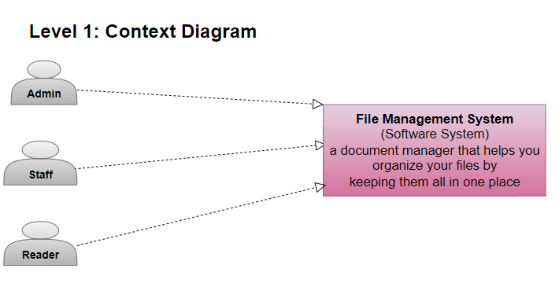

Slide 4
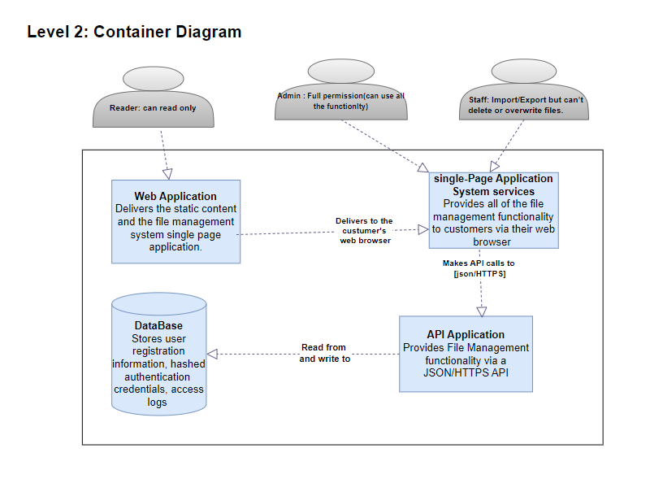

Slide 5
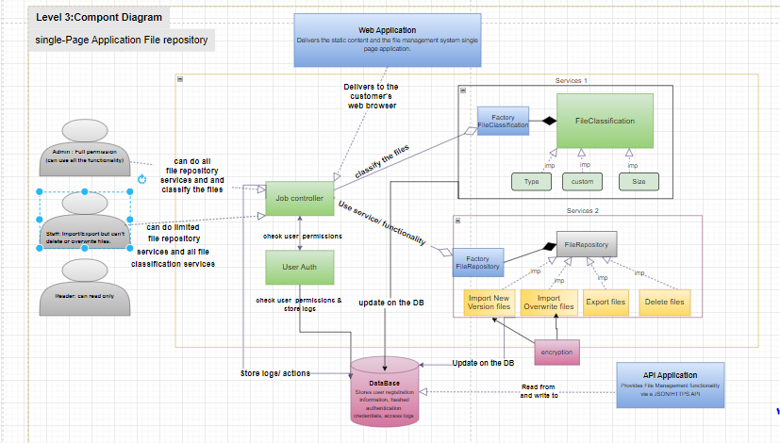

Slide 6
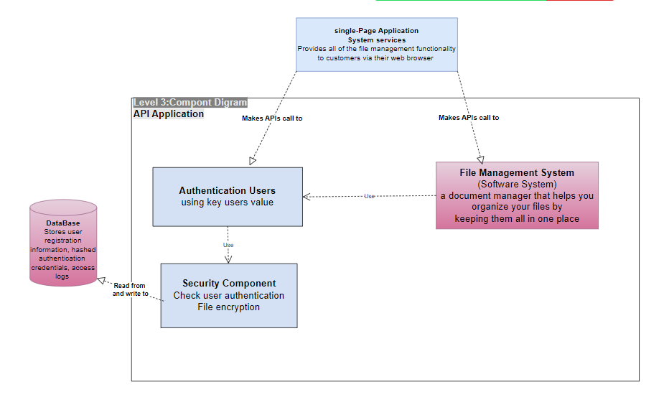

Slide 7
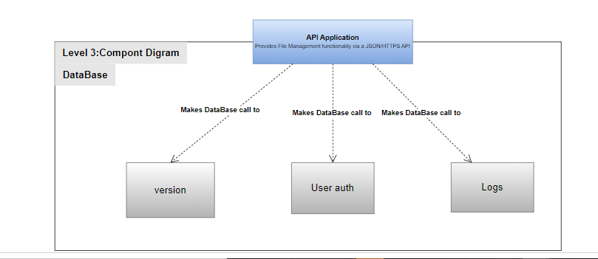

Slide 8
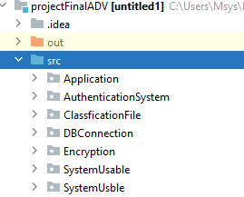

Slide 9
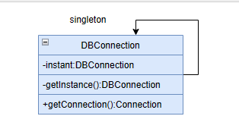

Slide 10
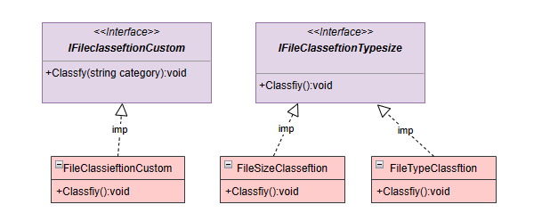

Slide 11
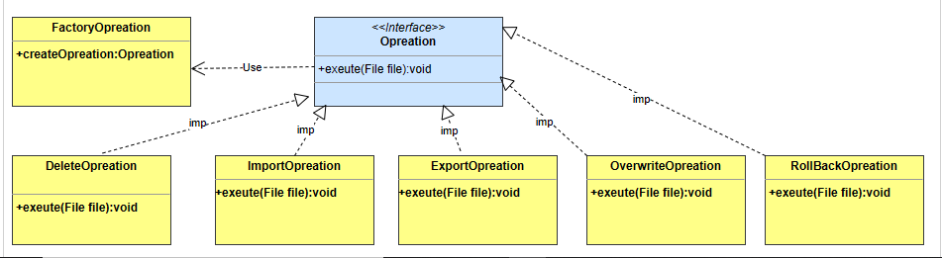
Factory Design pattern

